Slide 1

What's new in Flutter ?

Slide 2



Slide 3
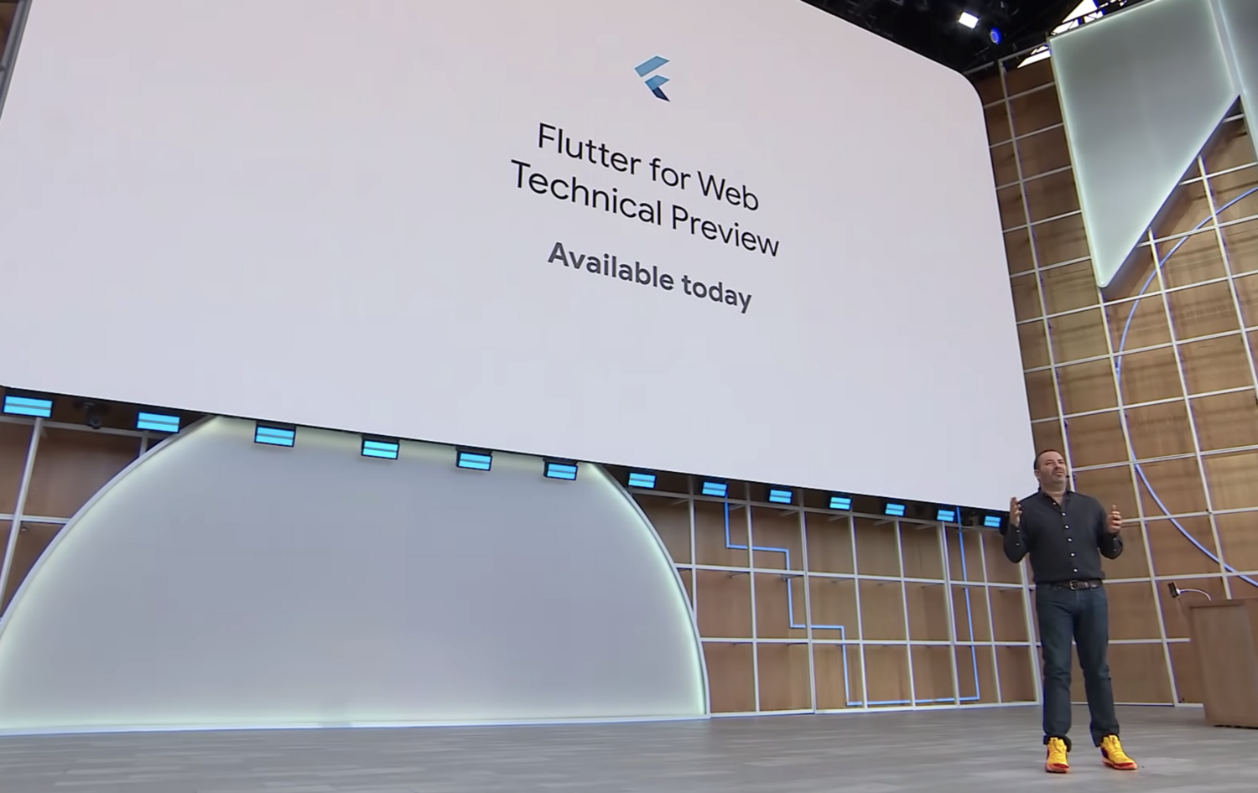
Flutter for Web

Slide 4

Flutter 1.5
preliminary support for targeting Windows, Mac and Linux operating systems.
New plug-ins for in-app payment, state management.
New samples for ML Kit-based image classification.

Slide 5
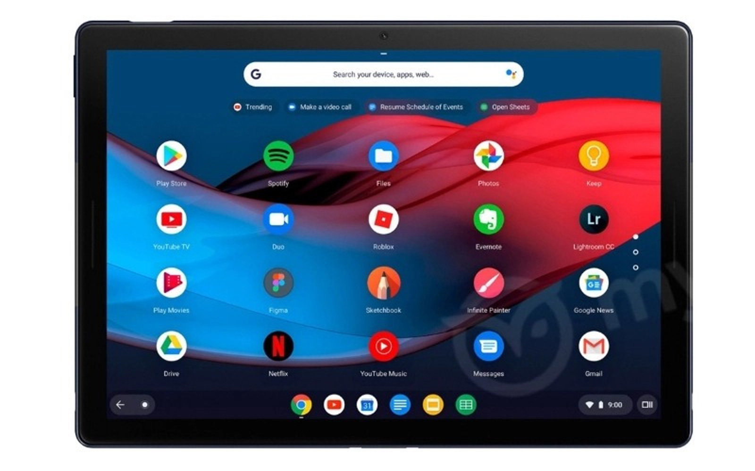
Support for developing on Chrome OS and publishing apps to Chrome OS.

Slide 6

Dart 2.3

Slide 7



New reference customers for Flutter announced

Slide 8
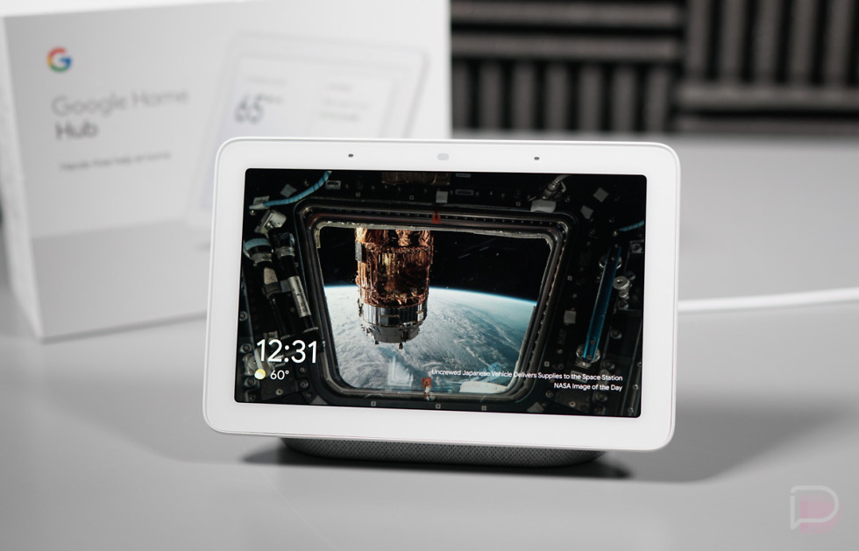
Google Nest Hub
The Assistant team is using Flutter for their smart display platform with Flutter, powering the UI of devices such as Google Nest Hub.

Slide 9


Updates for the Visual Studio Code and Android Studio tooling extensions.

Slide 10

- Flutter Create award winners announced, along with demo reel. - International community-organized Flutter hackathon on June 1st.

Slide 11
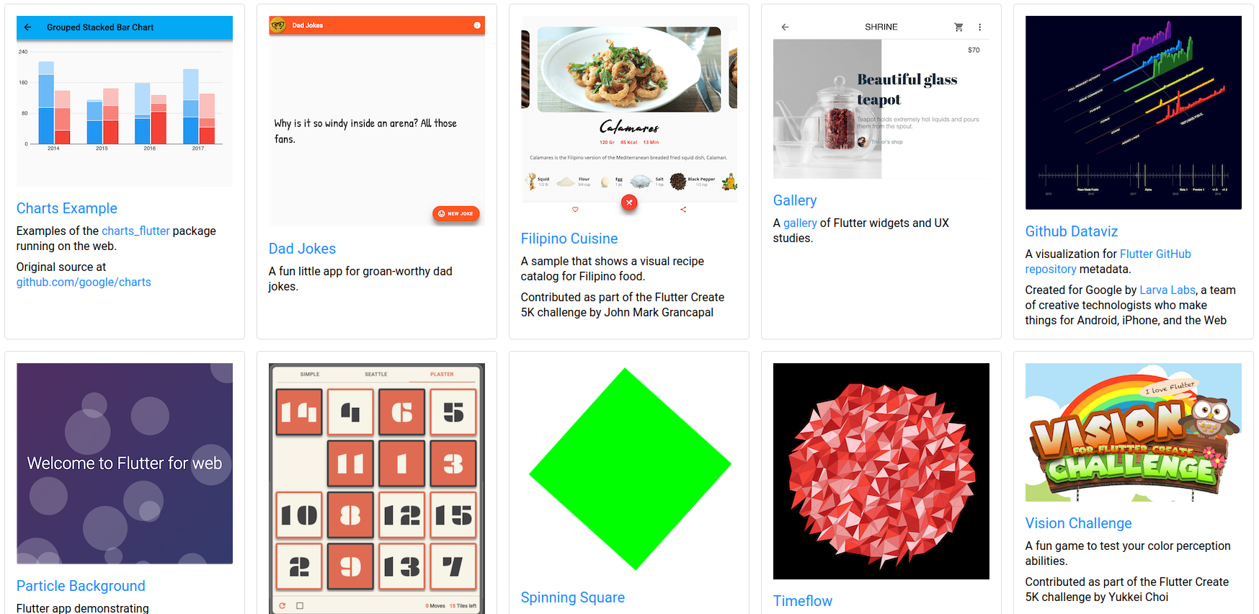
Flutter for Web samples
https://flutter.github.io/samples/

